Slide 1
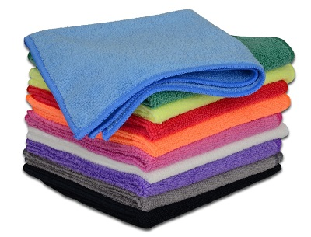

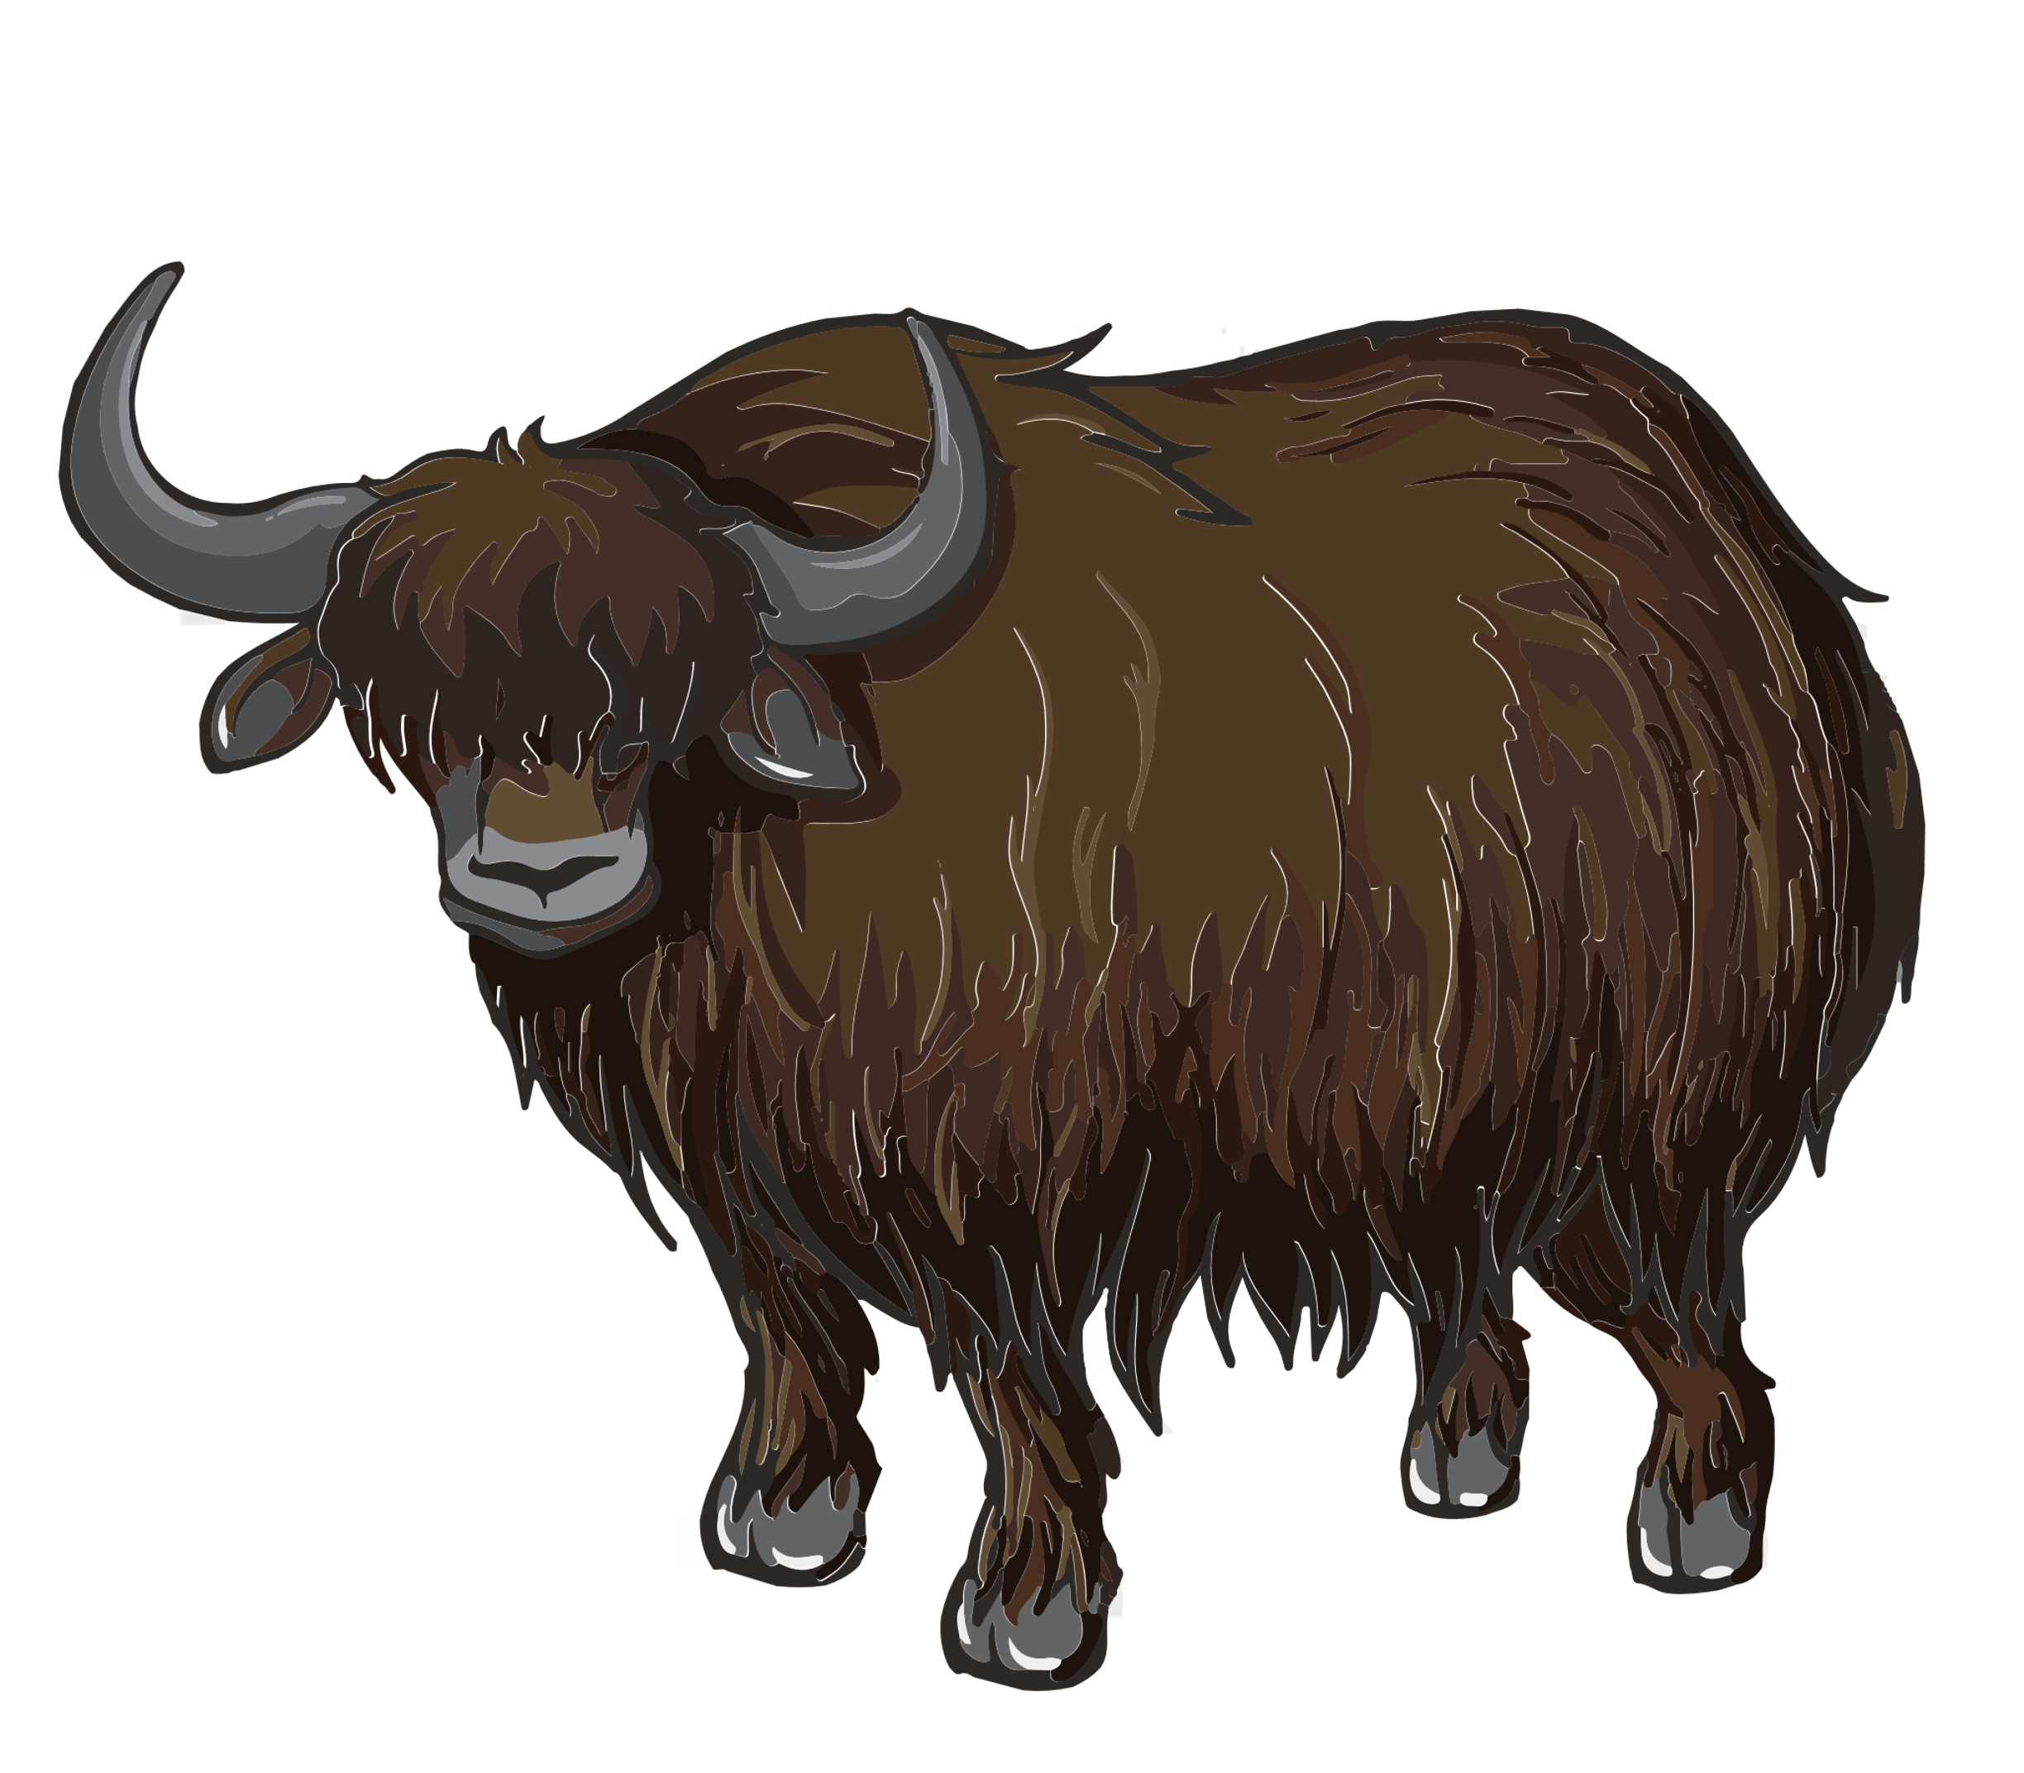
Fibre to Fabric
2
Fibres
Introduction
Fibre is a thin thread of natural or artificial substances. It is used to make cloths with the help of power looms or weaving machines. The fibres we get from plants and animals are called natural fibres. Cotton, jute, coir, flax, hemp are examples for plant fibres. Wool and silk are examples for animal fibres. Fibres made by humans by chemical synthesis are called synthetic fibres or artificial fibres. Rayon, nylon, acrylic and Dacron are examples for artificial fibres. These fibres are obtained from petroleum by complex chemical processes.
Animal Fibres
Introduction
Animal fibres are the natural fibres which is obtained from animals. The most popular examples of animal fibres include silk and wool.
1
Wool
Wool is one of the animal fibres which is obtained from sheep, yak, goat, etc. These wool yielding animals bear hair in their body because hairs trap a lot of air and a poor conductor of heat. So hair keeps these animals warm.
Vidyavantam — CBSE Class 7 Science
1
Nutrition

